Slide 1

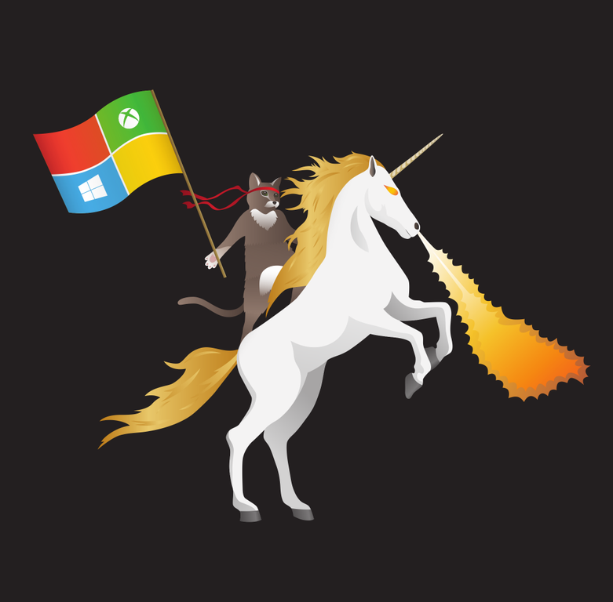
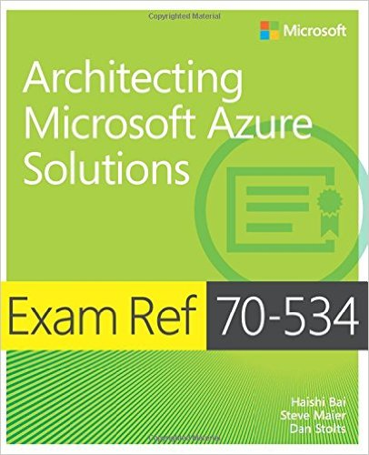



Containers in a flash
Dan Stolts (@ITProGuru) Chief Technology Strategist US DX North East – Audience Blog: ITProGuru.com
dstolts@Microsoft.com
www.linkedin.com/in/danstolts
Specializations:
Cloud, Virtualization, Windows Server
Open Systems, Hybrid Cloud, Storage
aka.ms/70-534-book
@ITProGuru
Notes:
Linux, Windows Server and Hyper-V Containers: What They Are, Which One to Use, Why and How, plus Integration with Azure Private/Public/Hybrid Cloud, with Microsoft A container is an isolated and portable operating environment. It provides a mechanism for IT to deploy services in a portable, repeatable and predictable manner. Container technology is the next evolution in virtualization, and in addition to Linux, Windows now also offers two different types of containers for addressing various business needs. In this session Dan Stolts, world renown Technical Evangelist at Microsoft and a dynamic/engaging presenter, will examine the similarities and differences between a container and a virtual machine, review the requirements and walk through the processes and essential operations of enabling, creating, deploying and managing Linux and Windows containers and resources. Mr. Stolts will also evaluate when to use which containers, why and how? For those who are new to containers, his delivery serves as a jumpstart to accelerate your learning of containers. If you have already had some experience on Linux containers, his session familiarizes you with the specifics on Windows containers and helps bridge and extend your skills for bringing business value to both Linux and Windows communities. Mr. Stolts will conclude this session by highlighting the top five new features in Microsoft's Azure cloud platform for 2017, and how to integrate your organization's public/private/hybrid cloud and container strategies. Lots of valuable content for infrastructure, data center and DevOps professionals.
Name of Presenter: Dan Stolts
Bio of Presenter (max 500 spaces): Dan Stolts “ITProGuru” is a technology expert who is a master of systems management and security. He is Chief Technology Strategist for Microsoft, owns several businesses and is a published author. Reach him on his primary blog http://itproguru.com or twitter @ITProGuru. He is proficient in many datacenter technologies (Windows Server, System Center, Virtualization, Cloud, Etc) and holds many certifications including MCT, MCITP, MCSE, TS, etc. Dan is currently specializing in system management, virtualization and cloud technologies. Dan is and has been a very active member of the user group community. Dan is an enthusiastic advocate of technology and is passionate about helping others. See more at: http://itproguru.com/about

Slide 2
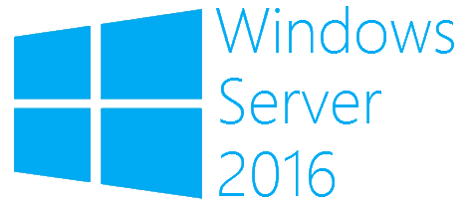
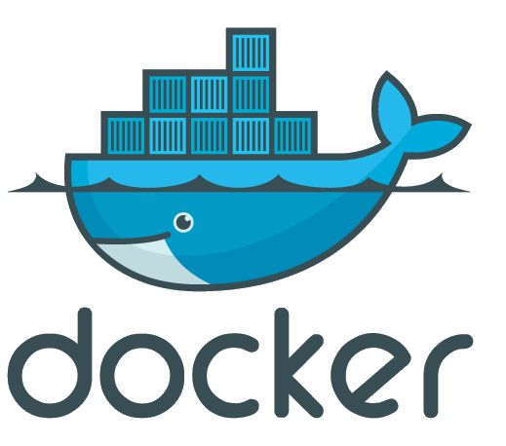
What is a container?
Containers
Windows Server containers Maximum speed and density
= Operating system virtualization
OS
Container
Container
Container
Applications
Container
Container
Container
Kernel
OS
Hardware
Kernel
Traditional virtual machines = hardware virtualization
Hyper-V containers Isolation plus performance
Application
VM
VM
VM
Container
Container
Container
OS
Hardware
Kernel
Kernel
Kernel
Hyper-V

Slide 3








Session VS VM (or VDI)
OS, Apps, Config, Mgmt
EACH Workload
Single OS
All Workloads
OS
OS
OS
OS
Apps
Apps
Apps
Apps
Massive VM Overhead
(Disk, Disk IO, Memory, CPU, OS, Licenses, Density, The works)
OS
OS
OS
OS
Apps
Apps
Apps
Apps
OS
OS
OS
OS
workloads
Apps
Apps
Apps
Apps
OS
OS
OS
OS
Apps
Apps
Apps
Apps
Application(s)
Application(s)
Operating
System
Operating
System
Parent OS
Hardware Virtualization
Hardware Virtualization
Hardware / Hypervisor Level
Session Based Computing
VM or VDI Based Computing

Slide 4
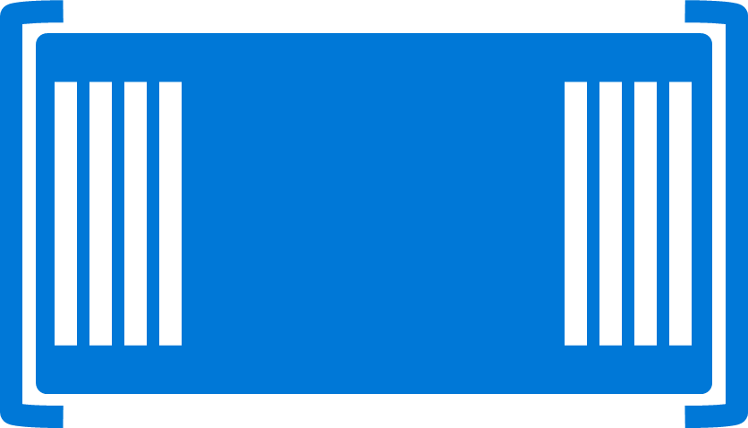

Containers
Single OS
All Workloads
OS
EACH Platform
App
App
App
App
App
App
App
App
App
App
App
App
App
App
App
App
App
App
App
App
App
App
App
App
All Advantages of VM & Session
Isolation, Little overhead
workloads
App
App
App
App
App
App
App
App
Container / Image
App
App
App
App
Container Engine
App
App
Linux VM
Container / Image
Container
Container
Application(s)
Container Engine
Container Engine
Operating
System
Operating
System
Parent OS
Hardware Virtualization
Hardware Virtualization
Hardware / Hypervisor Level
Container Based Density Advantages
Container Based Computing VM Isolation

Slide 5
Containers Deep Dive: Architecture of a Host
App
App
App
App
App
App
App
App
App
App
Copy on Write
Any layer that is SAVED or Downloaded is locked
Any workload
New Blank is created to allow write
Container Engine
Engine and Orchestration are different jobs, not always different products
Any workload can be set as a BASE by saving
It can then be used as a base, All required pieces below it will automatically be deployed
App
App
App
App
App
Web Sites
Web Site
Web App
App
App
Container Orchestration
Web Engine Config
IIS Config
Web Engine Config
Web Engine Base (IIS installed)
OS Base (eg. Nano)
Container Engine (Windows, Linux, Docker)
Operating
System
Hardware Virtualization

Slide 6



How Containers Run
Hyper-V Containers
on VM
Windows Server Containers on VM
Docker Containers
Windows Server Containers
Azure Containers
ACS … Containers As A Service
Virtual Machines
Linux OR Windows
Hyper-V Containers
Hyper-V Hypervisor
Docker Engine
Container Service
Container Service
VM
Linux
OS
Hyper-V Hypervisor
Windows Containers can run on Windows 10 and Nano too!
Azure
Abstracts VM
Windows Host

Slide 7

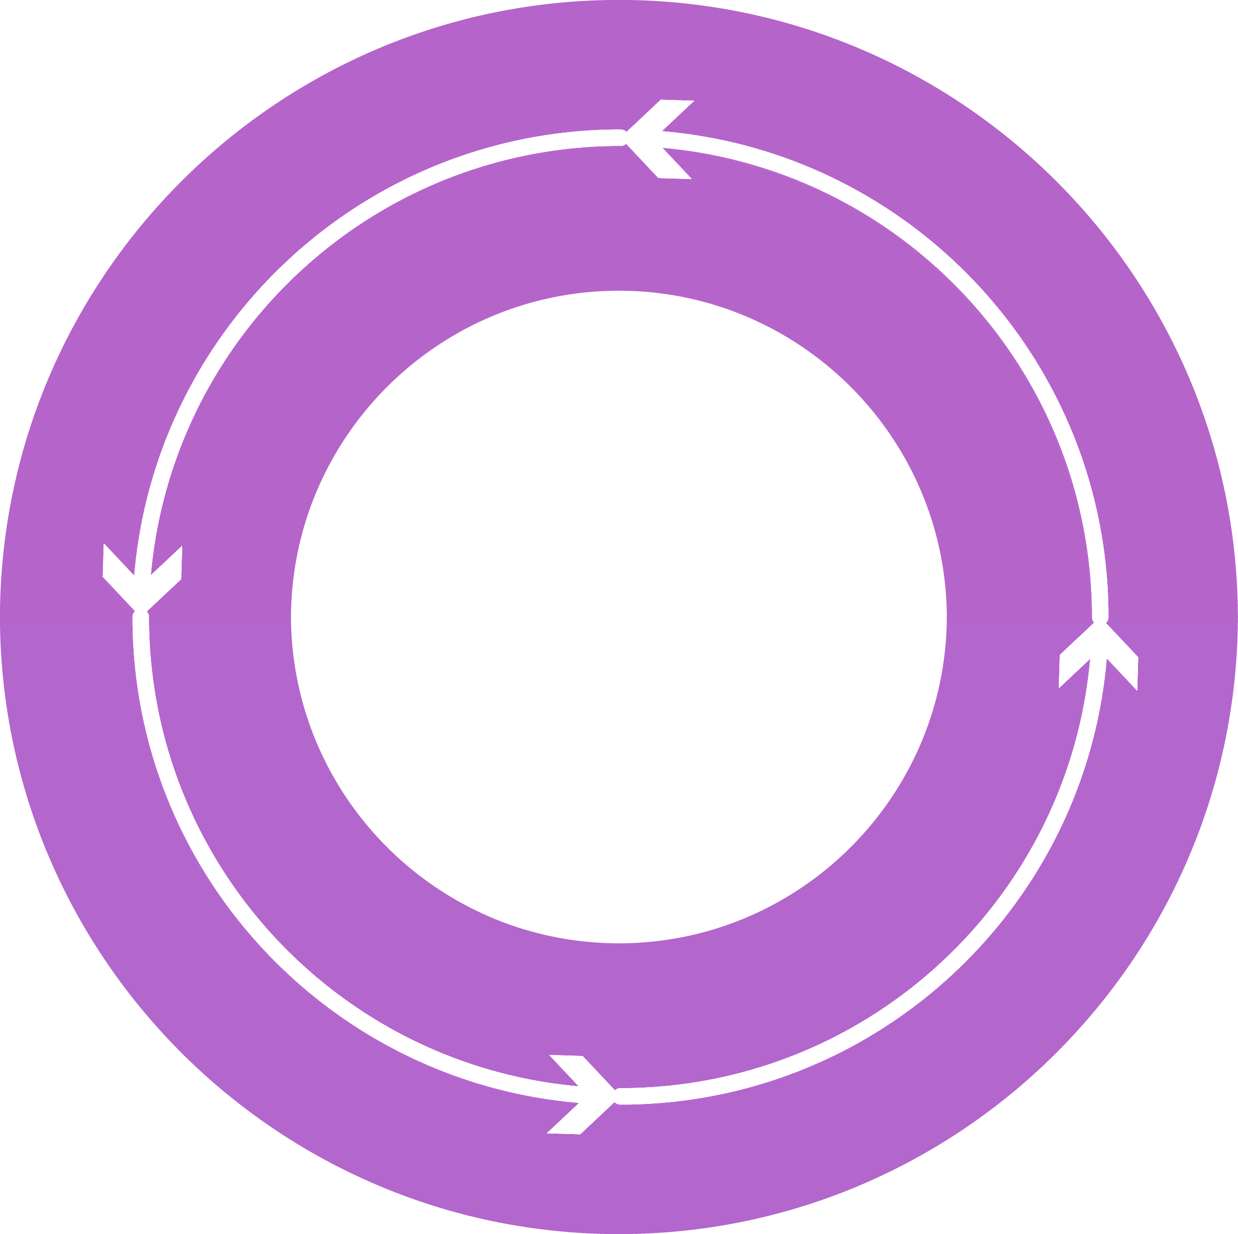




DevOps: the three stage conversation
DEV
DEV
OPS
OPS
2
2
Process
Process
3
3
Products
1
Tools
1
People
People
“Deliver a Product that Users Love!”
Notes:
People = Culture
Fundamental attributes of successful cultures:
Shared mission and incentives: infrastructure as code, apps as services, DevOps/all as teams
You need to consider your hardware as a commodity, (don't give your servers names) , servers are like farm animals, it is just harder if you let theids name them
Build deep instrumentation into services, push complexity up the stack
Rally around agile, shared metrics, CI, service owners on call, etc.
Changing the culture: any change takes time, changing culture is no exception and you can't do it alone, exploit compelling events to change culture: downtimes, cloud adoption, devops buzz
PROCESS Definition and design, compliance, and continuous improvement
PEOPLE Responsibilities, management, skills development, and discipline
Products Tools and infrastructure

Slide 8
DevOps & Monolithic vs Micro Services
Micro Services
Split Services into small pieces
Easily Scale, Deploy, code, etc.
Faster Execution
Higher Reliability
Faster MTTR mean time to repair
Agile capabilities
Automation Continuous Delivery
Amplify Feedback Loops
Monolithic
All Feature in Full App
Long Cycles (Dev, Test, Q/A, Deploy, update, etc.)
Error / Bug Prone
Expensive
Quick Fixes hard or impossible
More bottlenecks
Harder to test (more changes at once)
Application
Feature A
Feature C
Feature E
Feature B
Feature D

Slide 9
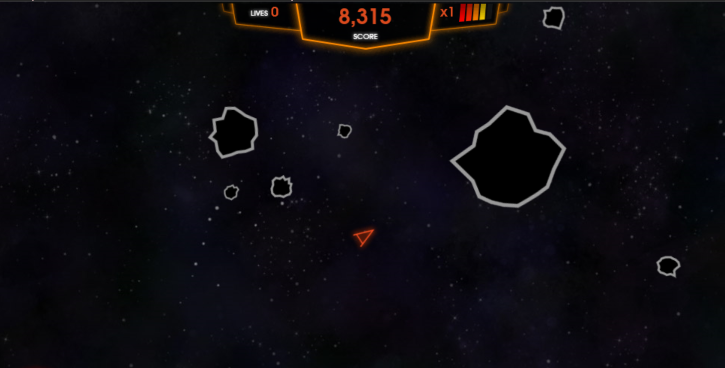
Monolith/Traditional vs Microservices/born in cloud
Asteroids

